Slide 1

Professional and Technical High School
Kissimmee, FL
“every student, future ready"

Slide 2
A School of Excellence
550+ Students and Growing!
100% Graduation Rate
100% of our student earn an Acceleration Point
  Participation in Advanced Placement, Dual-Enrollment, oTech DE, and Industry Certifications
Recognized as a School of Excellence by the Florida Department of Education
Rated as a Best High School by US News and World Report
“A” School for over 15 years!
Class of 2022 had 10% of the class earn their Valencia Associates Degree before walking across the stage at Heritage Park!

Slide 3
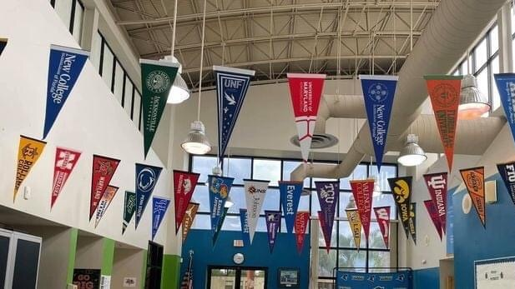
What We Offer
Strong focus on College & Career Pathways:
  Career Dual-Enrollment through Partnership with Osceola Technical College
  College Dual-Enrollment through Partnership with Valencia College
Individualized educational planning
Honors & Advanced Placement Coursework

Slide 4

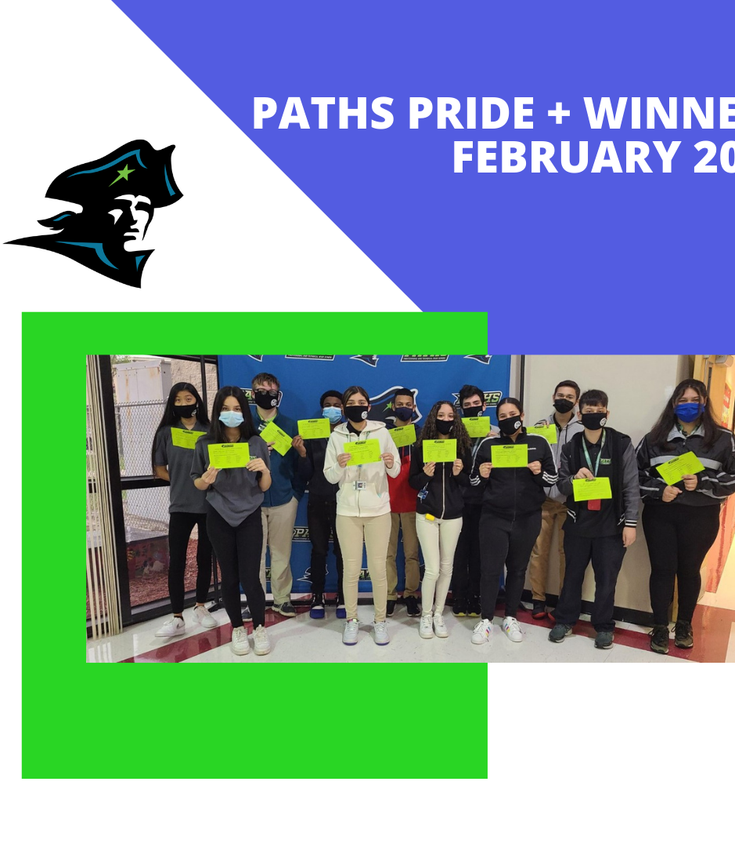
OUR PATRIOTS HAVE
P.R.I.D.E.
Professionalism
Responsibility
Integrity
Determination
Excellence

Slide 5
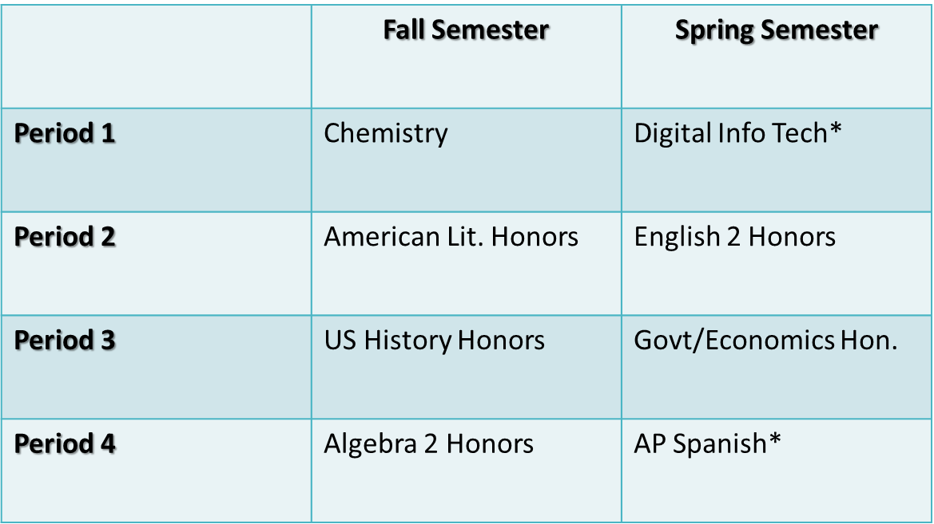
Unique Scheduling Approach
Block Schedule
  Four classes per day/per semester
  Approximately 85 minutes of instructional time
  Classes switch mid-year
  Opportunity for students to earn up to 8 credits per year
Notes:
Alignment of Academics and CTE Pathways, Changing population (new Patriot Period), some do both oTECH and VCC

Slide 6
Sample Schedule
 | Fall Semester | Spring Semester
Period 1 | OTech Pharmacy Tech | OTech Pharmacy Tech
Period 2 | OTech Pharmacy Tech | OTech Pharmacy Tech
Period 3 | Valencia DE | Valencia DE
Period 4 | Valencia DE | Valencia DE

Slide 7
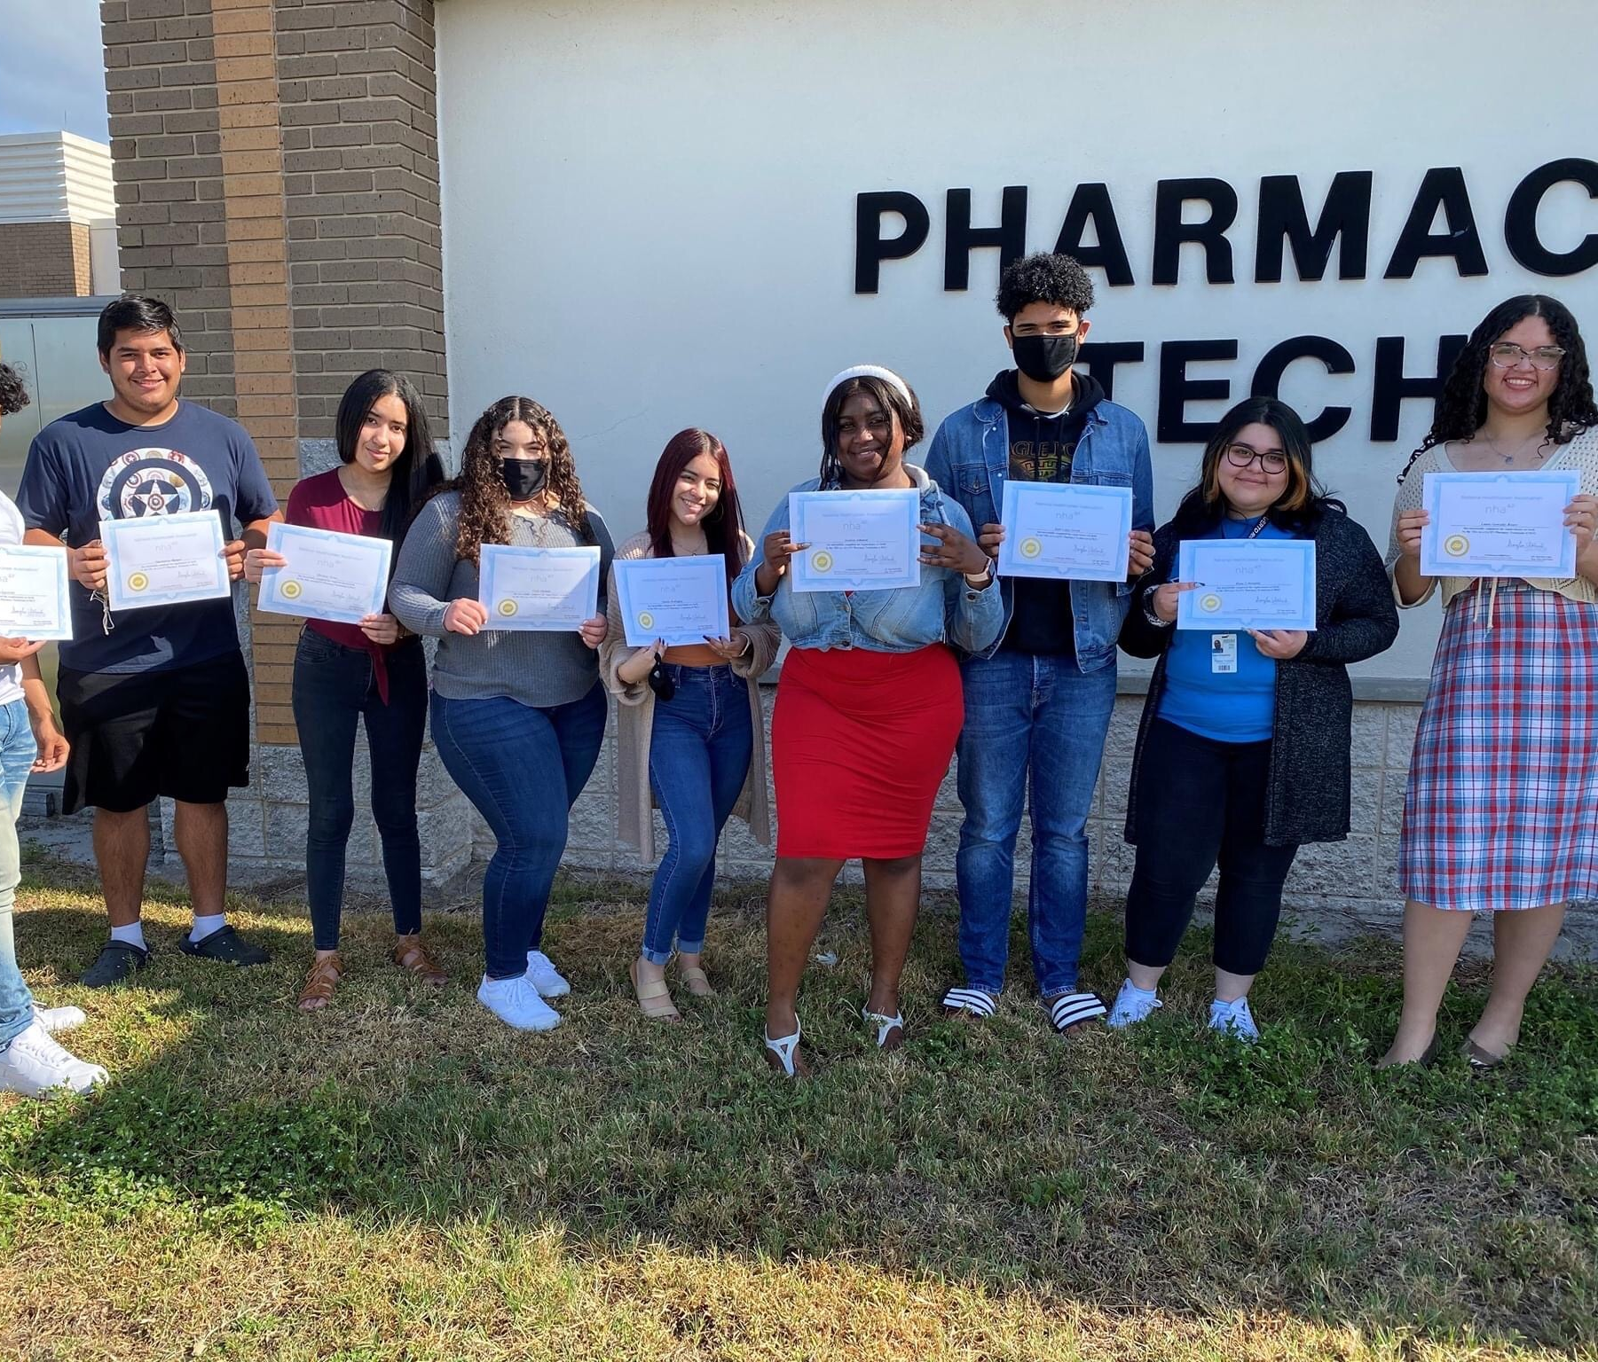
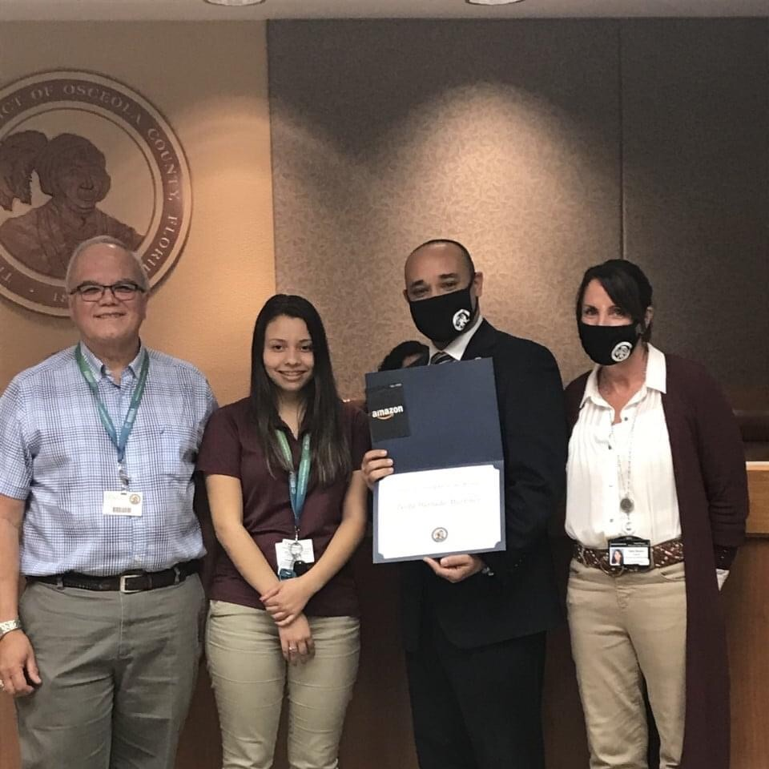

oTECH Programs
Health Science
Pharmacy Tech
Business Management
Accounting Operations
Computer Sciences
Cybersecurity
Network Support
Hospitality
Culinary
Industrial
Production Manufacturing
Electrical
HVAC
Plumbing
Automotive
Welding
Medical Assisting
Medical Coder Biller
Digital Design
Notes:
Post-Secondary credit, Required to take an oTECH program

Slide 8
oTECH Programs
All students will Dual-Enroll at Osceola Technical College
Hands on, skills-based training
Complete the program and receive Career Certificate
Industry Certifications
Qualified for work within career certification field
Great on college applications and resumes!
Notes:
Post-Secondary credit, Required to take an oTECH program

Slide 9


Health Science – Medical Programs
Pharmacy Technician-
2 Years, Part-time
Medical Coder Biller -
2 Years, Part-time
Medical Assisting- (Phlebotomy)
2 Years+, Part-time, Plus summer semester internship

Slide 10

Business Program: Accounting Operations
2 Years, Part-time

Slide 11

Hospitality Program – Culinary Arts
2.5 Years, Part-time

Slide 12

Computer Science Programs
Cybersecurity
  2 Years, part-time
Network Support
  2 Years, part-time
Digital Design
  2 Years, part-time

Slide 13

Industrial Programs
Production Manufacturing
  1.5 Years, Part-time
Electrical
  2 Years + Summer Semester, Part-time
Heating, Ventilation & Air Conditioning (HVAC)
  2 Years, Part-time
Plumbing
  2 Years, Part-time
Automotive Mechanics
  2 Years, Part-time
Welding Technology
  2 Years, Part-time

Slide 14


PATHS CAREER TECH PROGRAMS
CRIMINAL JUSTICE (4 COURSES)
Emergency Dispatcher Certification
BIOMEDICAL SCIENCE (4 COURSES)
BASE Certification
JOURNALISM AND MULTIMEDIA (4 COURSES)
Premiere Pro
Adobe
VALENCIA DE LAB ON CAMPUS

Slide 15
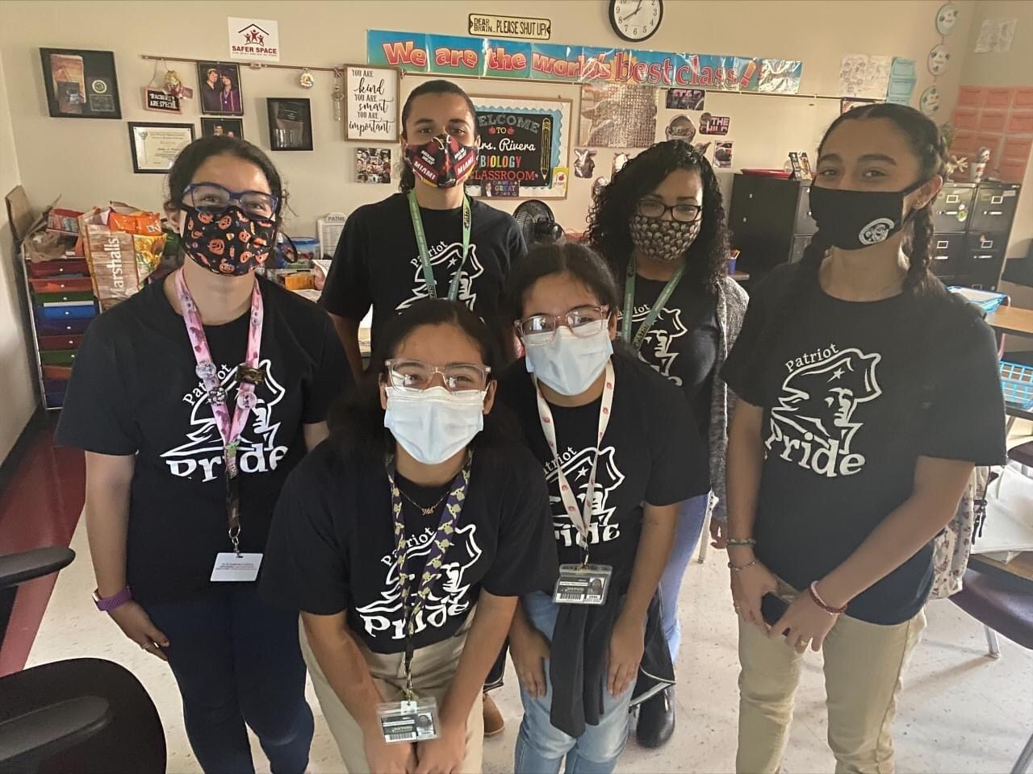
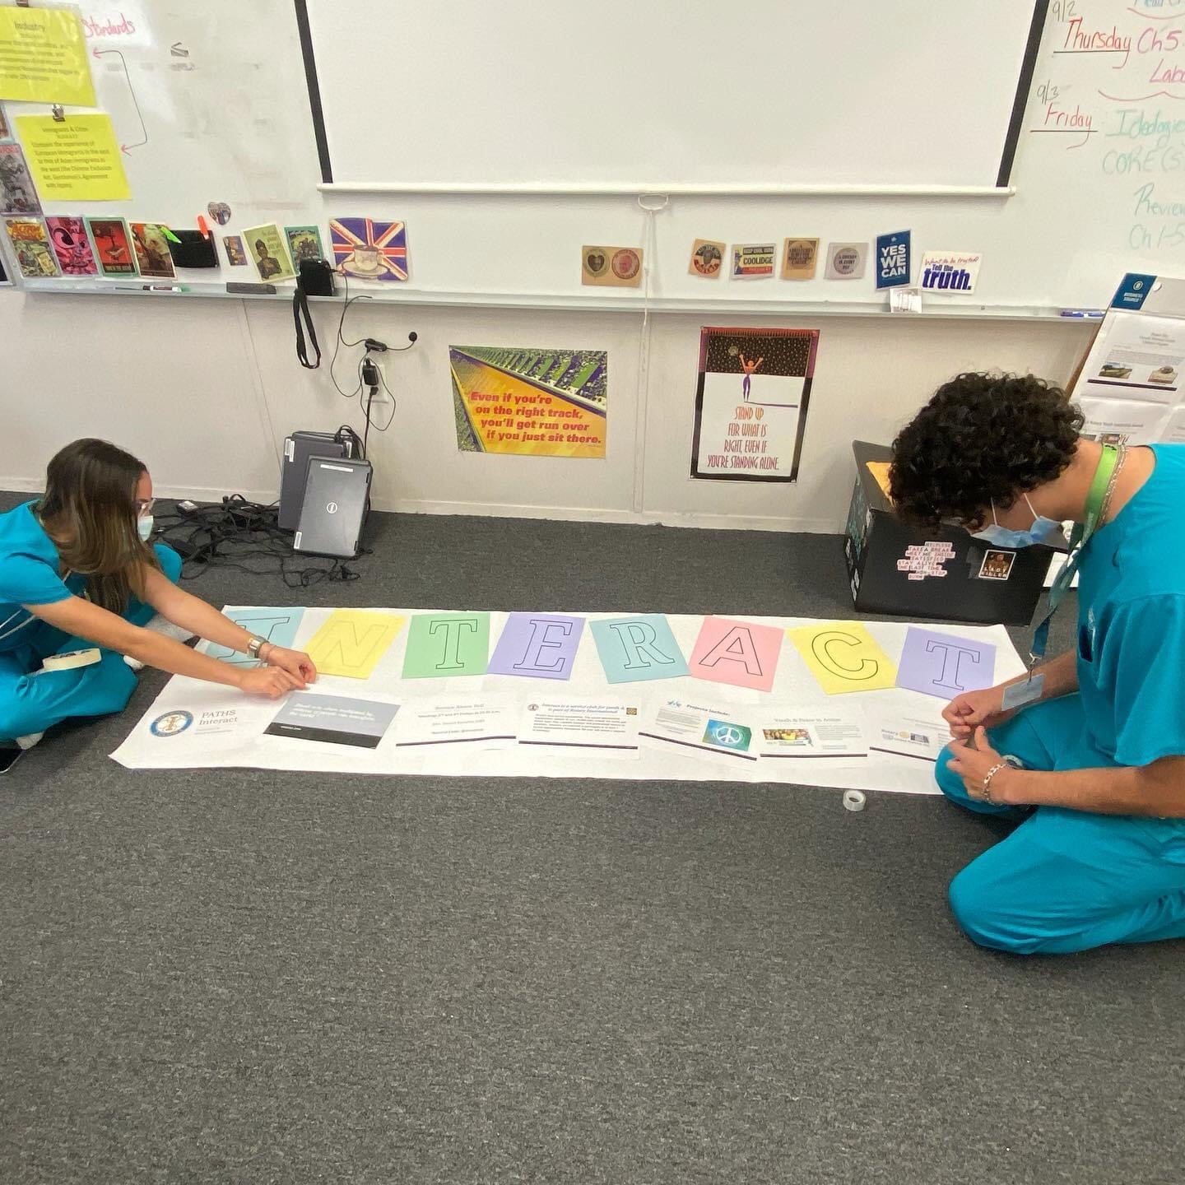
Student Life:
Lunchtime!
  Students get 1 hour and 15 minutes for lunch!
    Can be used for tutoring, sports, socializing, or club activities!
Clubs and Organizations: TONS to choose from!
Student Government
National Technical Honor Society
Spanish Honor Society
Odyssey of the Mind
Robotics Club
Black Student Union
Domino Club
Yearbook
Garden Club
Gay Straight Alliance (GSA)
Interact Club
Photography Club
Hosa
SkillsUSA
Spirit Week, Homecoming Dance, afterschool gatherings, Prom, GradBash

Slide 16

How to Apply
Complete both Choice and PATHS Applications
*Complete Teacher Recommendation Forms (*your app will not be considered until this is in)
*If from a private school, all 7th/8th grade records need to be sent to PATHS
Acceptance based on review of student’s state assessment scores, behavior history, attendance, grades, and teacher recommendations
by Jan 15th
Need help applying? Email Victoria.FunkSummers@osceolaschools.net

Slide 17
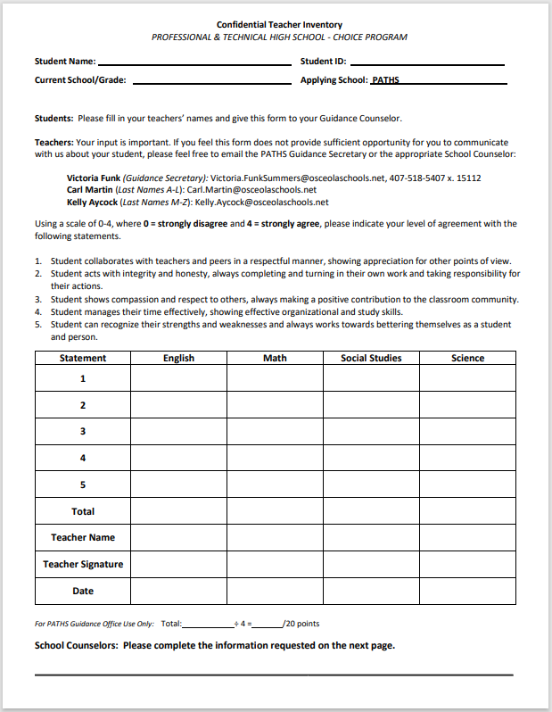
Application Process
Complete Choice Application
Complete PATHS Application
Teacher Recommendation Forms
Await communication with any additional steps/documents needed.
Acceptance based on review of state assessment scores, behavior history, attendance, grades, teacher recommendations

Slide 18
Want to Learn More?
Take a look at our PATHS website for more details
Professional and Technical High (PATHS) / Homepage (osceolaschools.net)
More info available on the oTECH website

Slide 19
